Slide 1
A Convolutional Neural Network for Image Classification of Cats and Dogs
Status update

Slide 2
Structure
Neural Nets (NN)
Convolution NN (CNN)
Problem
Evaluation
Aims

Slide 3
Neural Nets

Slide 4
Introduction – Neural Nets
W₁₁
W’₁₁
W₁₂
W’₁₂
…
…
W_{1n}
W’_{1n}
Input
Hidden
Hidden
Output
Quelle: http://cs231n.github.io/convolutional-networks/
Notes:
Based on pretty basic ideas
Image is a 2-D array of images
Looking at it CNN decides if Pictures is X or O.

Slide 5
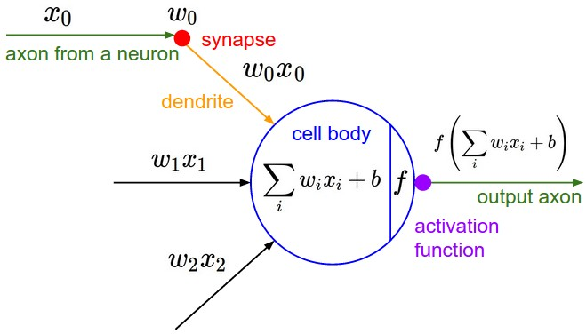
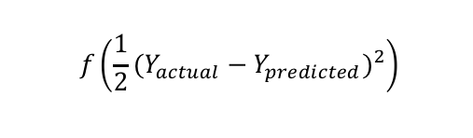
Neuron Model
Cost Function
$$f\left(\frac{1}{2}{(Y_{actual}−Y_{predicted})}^{2}\right)$$

Slide 6

Mathematical view
Input, Weights
Compute Sigmoid (Activation Function)
Measure how much we missed (Cost Function)
Multiply Err by the Sigmoid slope
Update Weights
$l_{0}=X_{i}$, W = rand()
$l_{1}=Sig\left(X_{i} . W\right)$
Err = $l_{0}−l_{1}$
${∆l}_{1}$ = Err*$∆\left(Sig\left(Err\right)\right)$
W = W+($l_{0}.{∆l}_{1}$)

Slide 7
Activation Functions
Non-Linear
sigmoid, tanh, elu, softplus, and softsign
continuous but not everywhere differentiable functions
relu, relu6, crelu and relu_x

Slide 8
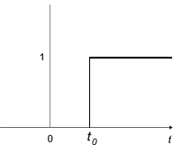
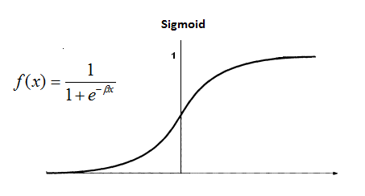
Activation functions
Why Sigmoid?
Not telling in which direction should we move in.
Non-differentiability at certain points

Slide 9
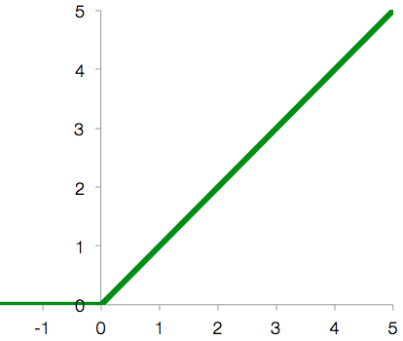
Activation functions
Why Relu?
Accelerates the convergence rate
Simply implementation

Slide 10
Cost Functions
Squared Error Measure
Softmax Cross-entropy Function

Slide 11
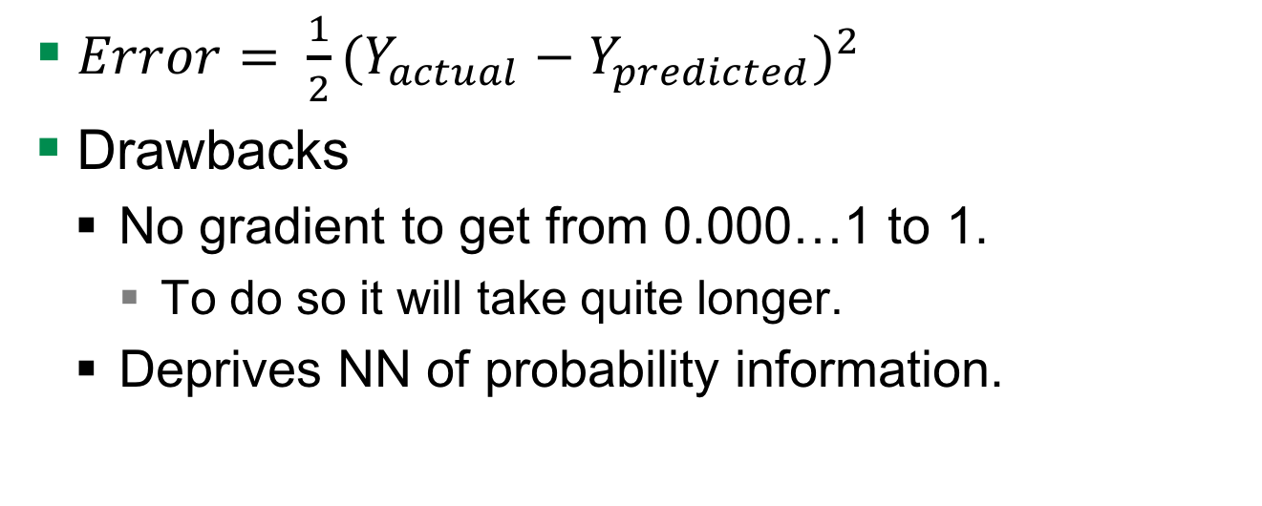
Squared Error Measure Function
$Error= \frac{1}{2}{(Y_{actual}−Y_{predicted})}^{2}$
Drawbacks
No gradient to get from 0.000…1 to 1.
To do so it will take quite longer.
Deprives NN of probability information.

Slide 12
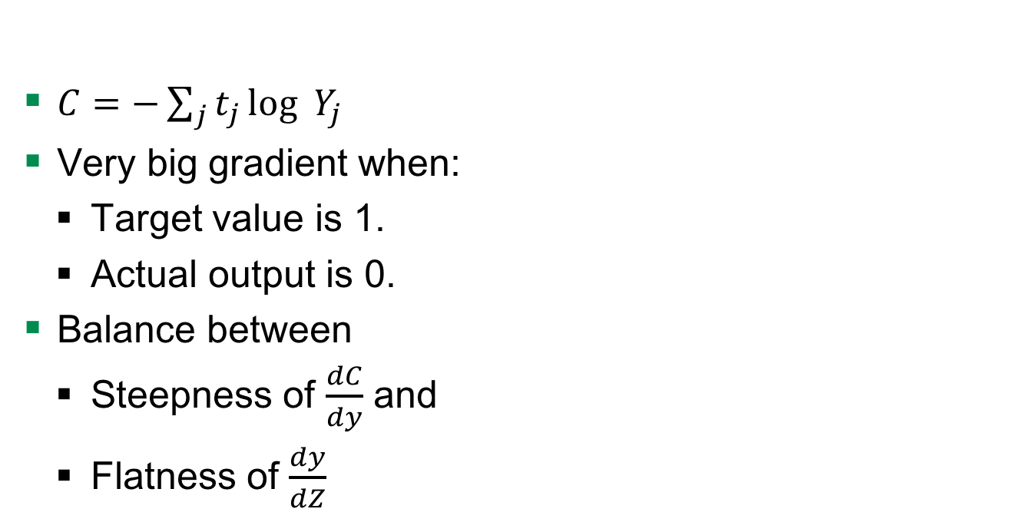
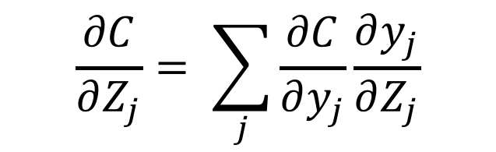
Advantages to Squared Error Measure
$C=−\sum_{j}^{ }{t_{j}}\log_{ }{Y_{j }}$
Very big gradient when:
Target value is 1.
Actual output is 0.
Balance between
Steepness of $\frac{dC}{dy}$ and
Flatness of $\frac{dy}{dZ}$
$$\frac{∂C}{∂Z_{j}}= \sum_{j}{\frac{∂C}{∂y_{j}}\frac{∂y_{j}}{∂Z_{j}}}$$

Slide 13
Convolutional NN

Slide 14
Neural Nets to CNN
W₁₁
W’₁₁
W₁₂
W’₁₂
…
…
W_{1n}
W’_{1n}
Input
Hidden
Hidden
Output
Quelle: http://cs231n.github.io/convolutional-networks/
Notes:
Based on pretty basic ideas
Image is a 2-D array of images
Looking at it CNN decides if Pictures is X or O.

Slide 15
Introduction – Neural Nets
W₁₁
W’₁₁
Bias
W₁₂
W’₁₂
W₁₃
Stride
W₁₁
…
W₁₂
W’_{1n}
W₁₃
Input
Feature Map
Fully Connected
Layer
Output
Quelle: http://cs231n.github.io/convolutional-networks/
Notes:
Based on pretty basic ideas
Image is a 2-D array of images
Looking at it CNN decides if Pictures is X or O.

Slide 16

TensorFlow
Developed by Google Brain Team
Use cases
Handwritten patterns, image recognition, Word2Vec
Input data
Audio, image, text
Used techniques
Linear classifiers, NN
Notes:
Google Brain Team is a deep learning research project at Google

Slide 17
Structure of the CNN we used
input
conv
pool
norm
conv
norm
pool
local
local
Softmax linear
Notes:
NN with multiple hidden layers, because it is passed to several non-linearity functions -> Deep learning
Over time the original image is reduced in size more and more

Slide 18
Input layer
input
conv
pool
norm
conv
norm
pool
local
local
Softmax linear
Notes:
NN with multiple hidden layers, because it is passed to several non-linearity functions -> Deep learning

Slide 19
Convolutional layer - Filter
Input
Filter
Output
0 | 0 | 0 | 0 | 0 | 0 | 0
0 | 2 | 1 | 0 | 0 | 2 | 0
0 | 2 | 2 | 2 | 0 | 2 | 0
0 | 1 | 2 | 0 | 2 | 0 | 0
0 | 2 | 1 | 2 | 1 | 2 | 0
0 | 1 | 2 | 1 | 0 | 0 | 0
0 | 0 | 0 | 0 | 0 | 0 | 0
0 | 0 | 0
0 | 2 | 1
0 | 2 | 2
1
1*0 + 2*0 + 0*0 +
0*0 + 0*2 + 0*1 +
0*0 + 0*2 + 0*2 +
1 = 1
Bias
1
http://cs231n.github.io/convolutional-networks/
input
conv
pool
norm
conv
norm
pool
local
local
Softmax linear
Notes:
NN with multiple hidden layers, because it is passed to several non-linearity functions -> Deep learning

Slide 20
Convolutional layer - Parameters
Input volume size
Number of filters
Filter size
Zero padding
Input
Filter
0 | 0 | 0 | 0 | 0 | 0 | 0
0 | 2 | 1 | 0 | 0 | 2 | 0
0 | 2 | 2 | 2 | 0 | 2 | 0
0 | 1 | 2 | 0 | 2 | 0 | 0
0 | 2 | 1 | 2 | 1 | 2 | 0
0 | 1 | 2 | 1 | 0 | 0 | 0
0 | 0 | 0 | 0 | 0 | 0 | 0
0 | 0 | 0
0 | 2 | 1
0 | 2 | 2
input
conv
pool
norm
conv
norm
pool
local
local
Softmax linear
Notes:
NN with multiple hidden layers, because it is passed to several non-linearity functions -> Deep learning
Volume size is width x heigth x depth

Slide 21
Convolutional layer – Activation function
Sigmoid
Not telling in which direction should we move in.
Non-differentiability at certain points
input
conv
pool
norm
conv
norm
pool
local
local
Softmax linear
Notes:
NN with multiple hidden layers, because it is passed to several non-linearity functions -> Deep learning
Volume size is width x heigth x depth

Slide 22
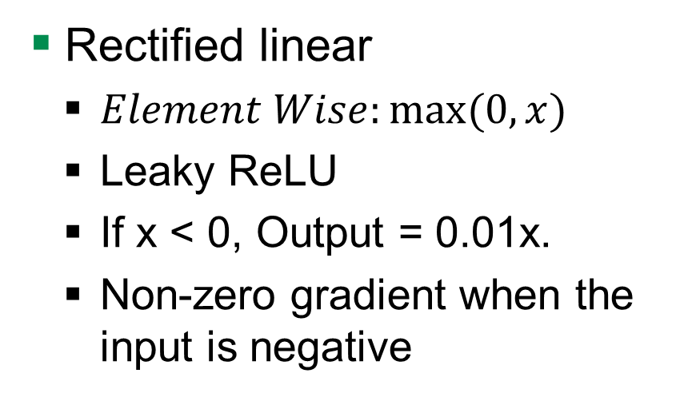
Convolutional layer – Activation function
Rectified linear
$Element Wise:max⁡(0, x)$
Leaky ReLU
If x < 0, Output = 0.01x.
Non-zero gradient when the input is negative
input
conv
pool
norm
conv
norm
pool
local
local
Softmax linear
Notes:
NN with multiple hidden layers, because it is passed to several non-linearity functions -> Deep learning
Volume size is width x heigth x depth

Slide 23
Pool layer
input
conv
pool
norm
conv
norm
pool
local
local
Softmax linear
Notes:
NN with multiple hidden layers, because it is passed to several non-linearity functions -> Deep learning

Slide 24
Pool layer – Max pooling
Reduce the spatial dimension of an image
1 | 1 | 2 | 4
5 | 6 | 7 | 8
3 | 2 | 1 | 0
1 | 2 | 3 | 4
6 | 8
3 | 4
http://cs231n.github.io/convolutional-networks/
input
conv
pool
norm
conv
norm
pool
local
local
Softmax linear
Notes:
NN with multiple hidden layers, because it is passed to several non-linearity functions -> Deep learning
Max pool with 2x2 filters and stride 2

Slide 25
Norm layer
input
conv
pool
norm
conv
norm
pool
local
local
Softmax linear
Notes:
NN with multiple hidden layers, because it is passed to several non-linearity functions -> Deep learning

Slide 26
Local layer
input
conv
pool
norm
conv
norm
pool
local
local
Softmax linear
Notes:
NN with multiple hidden layers, because it is passed to several non-linearity functions -> Deep learning

Slide 27
Softmax-linear layer
input
conv
pool
norm
conv
norm
pool
local
local
Softmax linear
Notes:
NN with multiple hidden layers, because it is passed to several non-linearity functions -> Deep learning

Slide 28
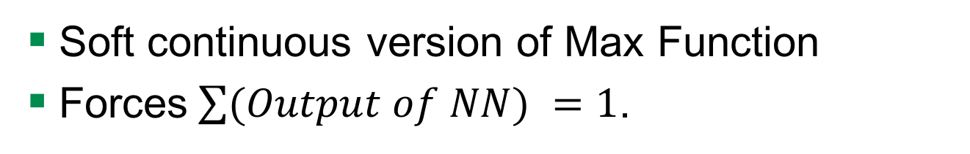
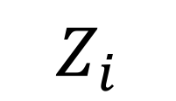

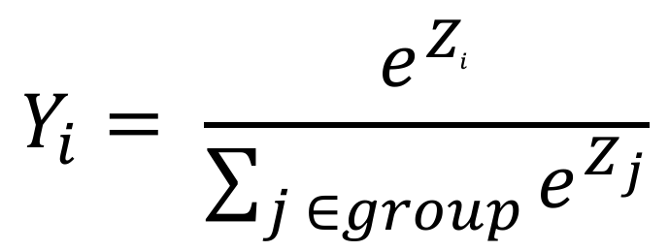
Softmax Output Function
Soft continuous version of Max Function
Forces$\sum{(Output of NN) }=1$.
$$Y_{i}$$
$$Y_{i}= \frac{e^{Z_{i}^{ }}}{\sum_{j ∈group}^{ }{e^{Z_{j}}}}$$
$$Z_{i}$$
Notes:
So Y lies between 0 to 1…..

Slide 29
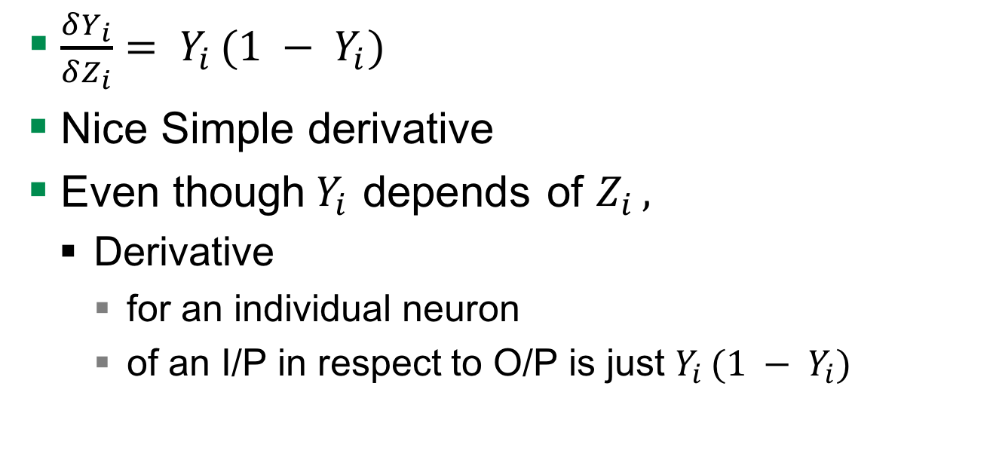
Derivative Softmax
$\frac{δY_{i}}{δZ_{i}}= Y_{i }(1 − Y_{i})$
Nice Simple derivative
Even though$Y_{i }$depends of $Z_{i },$
Derivative
for an individual neuron
of an I/P in respect to O/P is just $Y_{i }(1 − Y_{i})$

Slide 30
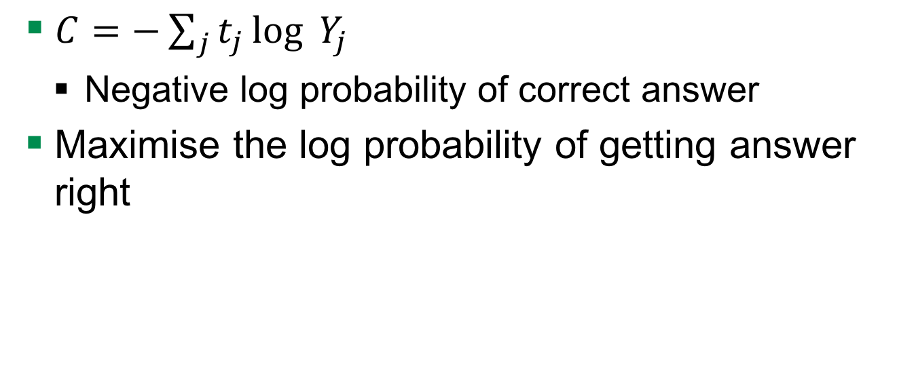
Cost Measure for Softmax Output Function
$C=−\sum_{j}^{ }{t_{j}}\log_{ }{Y_{j }}$
Negative log probability of correct answer
Maximise the log probability of getting answer right

Slide 31
Hyperparameters

Slide 32
Learning Rate
how fast the network trains
High learning rate
Convergence or global minimum finding is problem
Low learning rate
High training times

Slide 33
Learning Rate decay
Learning rate decay means the learning rate decreases over time
higher learning rate is well suited to get close to the global minimum
small learning rate is better at fine tuning the global minimum
Several ways to do it:
Exponential decay, reduction by factor of n
GoogLeNet: function to decrease the learning rate by 4%

Slide 34
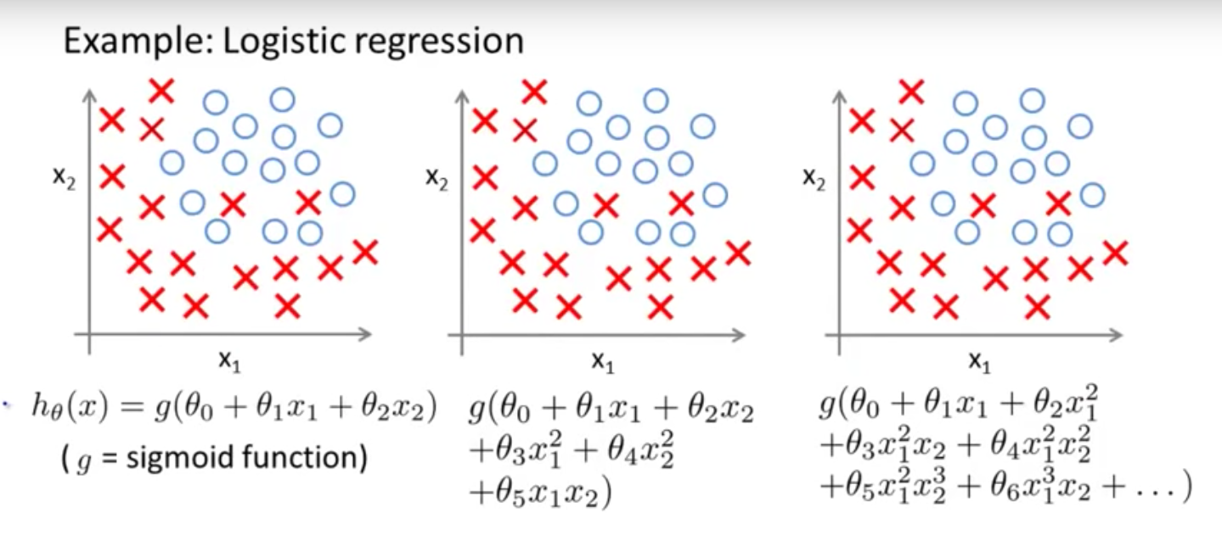
Overfitting or Underfitting

Slide 35
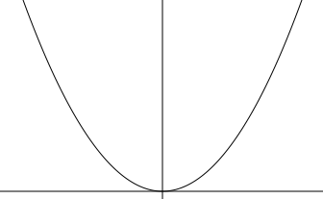

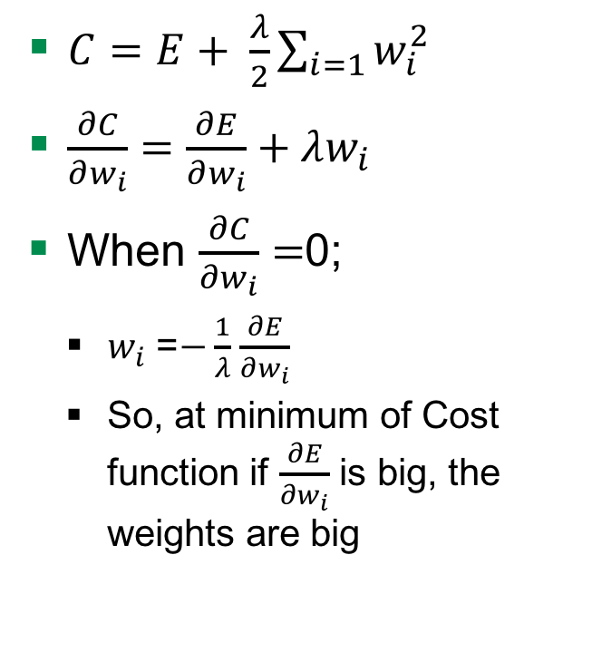
Weight Penalty
$C=E+ \frac{λ}{2}\sum_{i=1}{w_{i}^{2}}$
$\frac{∂C}{∂w_{i}}=\frac{∂E}{∂w_{i}}+λw_{i}$
When $\frac{∂C}{∂w_{i}}=$0;
$w_{i}$ =$−\frac{1}{λ}$ $\frac{∂E}{∂w_{i}}$
So, at minimum of Cost function if $\frac{∂E}{∂w_{i}}$ is big, the weights are big
Adding $λ$to penalise
Keeps weight small
Big error derivatives
C
W
Notes:
Derivative of penalty is the force pulling down to zero

Slide 36


Weight Penalty - Advantages
Preventing network from the weights it does not need
Don’t have a lot of weights not doing anything
So output changes more slowly as input changes.
Putting half the weight on each and not on one
W
0
$$\frac{w}{2}$$
$$\frac{w}{2}$$

Slide 37
Problem

Slide 38
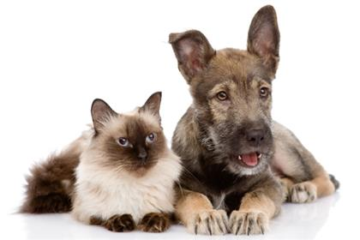
The data
Images of cats and dogs
File format is *.jpg
Color space is RGB

Slide 39
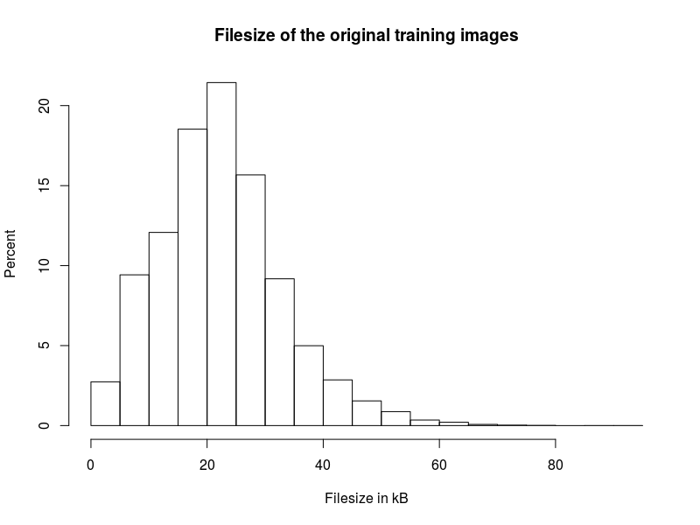
Training data
25,000 images
12,500 of dogs
12,500 of cats
Avg. file size
22.34 kB

Slide 40
Test data
12,500 images
x of dogs
y of cats
x + y = 12,500

Slide 41
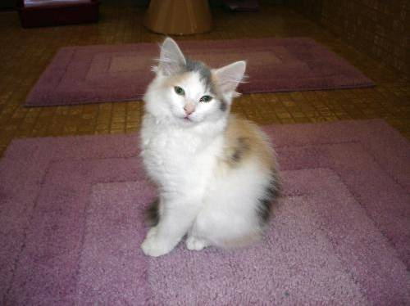
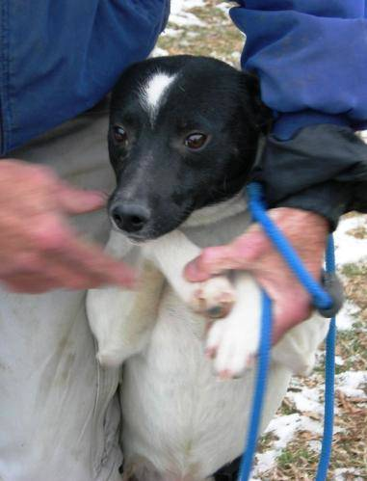
Process images
Resize to 32 * 32 * 3
Convert to array
25,000 * 3,073
cat10.jpg
dog1.jpg

Slide 42


Process images
Resize to 32 * 32 * 3
Convert to array
25,000 * 3,073
cat10.jpg
dog1.jpg

Slide 43
Evaluation

Slide 44
AIMS

Slide 45
Aims
Removing normalization layer
Notes:
No advantage in normalization

Slide 46
Questions

Slide 47
Quellen
http://cs231n.github.io/convolutional-networks/
https://www.tensorflow.org/tutorials/deep_cnn/
Maas, Andrew L., Awni Y. Hannun, and Andrew Y. Ng. "Rectifier nonlinearities improve neural network acoustic models." Proc. ICML. Vol. 30. No. 1. 2013.

Slide 48
Today‘s Talk
Problem Statement
Introduction to Deep Learning
Layers In Deep Learning
TensorFlow
Methods
DataSets
Training Time
TensorFlow (TF)
Data-Structure for TensorFlow
Implementation in TF
Inputs
Prediction
Training
Evaluation
Results
Future Works

Slide 49
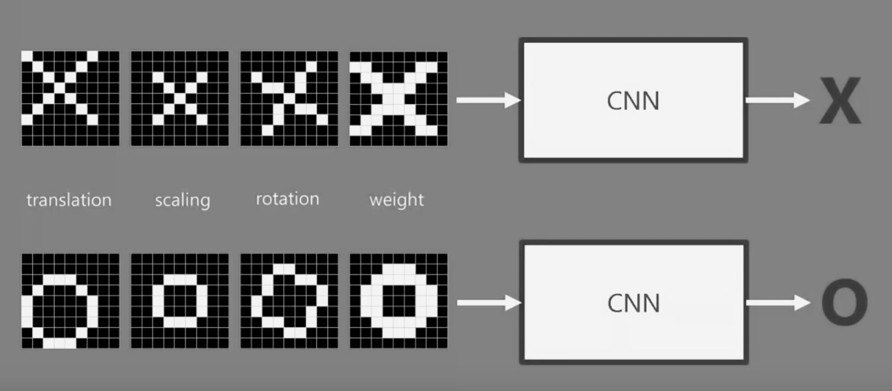
Problem Statement - Explained
Neural Net
NN
Neural Net

Slide 50
Introduction – Neural Nets
W₁₁
W’₁₁
W₁₂
W’₁₂
…
…
W_{1n}
W’_{1n}
Input
Hidden
Hidden
Output
Quelle: http://cs231n.github.io/convolutional-networks/
Notes:
Based on pretty basic ideas
Image is a 2-D array of images
Looking at it CNN decides if Pictures is X or O.

Slide 51
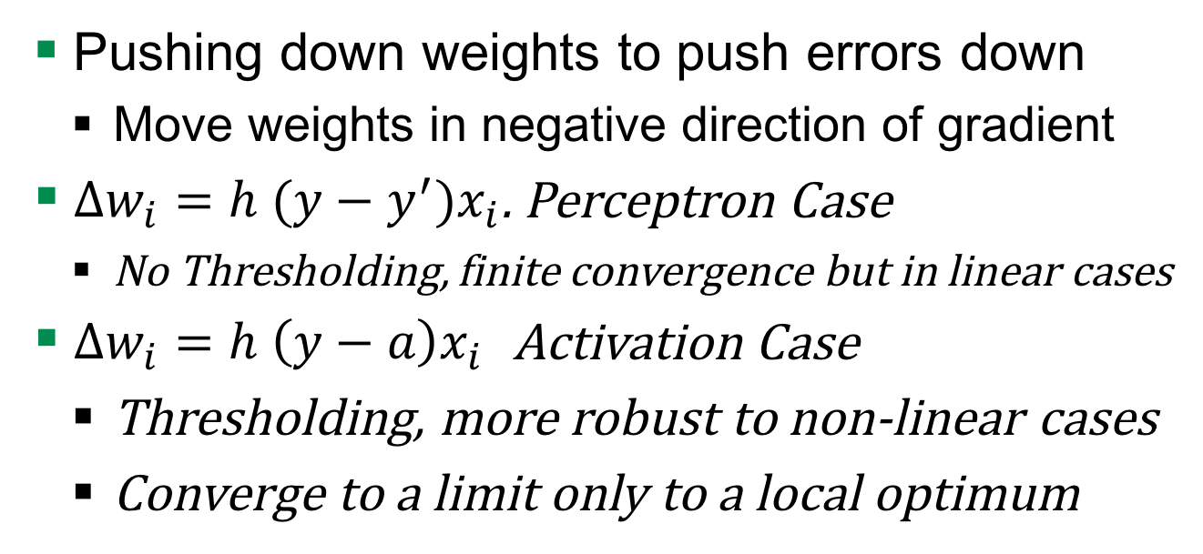
Gradient Descent
Pushing down weights to push errors down
Move weights in negative direction of gradient
$∆w_{i}=h (y−y^{′})x_{i}$. Perceptron Case
No Thresholding, finite convergence but in linear cases
$∆w_{i}=h \left(y−a\right)x_{i}$ Activation Case
Thresholding, more robust to non-linear cases
Converge to a limit only to a local optimum

Slide 52
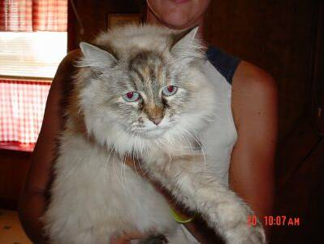
Why not just Neural Nets?
Input 32*32*3 = 3072
Weights 3072*N
Biases N
So,
Full connectivity is wasteful
Huge number of parameters
Loss of spatial information
How 3072 input signals represent 32*32*3 matrix ?
Deconvolution
Notes:
Deducing what multilayer perceptrons has learned is impossible to understand.

Slide 53
Convolutional Neural Network (CNN)
CNN
CNN
Notes:
What Computers See
When using If and else, we can not say that if it is X or O
If the pixels do not match for a given X and rotated X then it can either do or not do.

Slide 54
CNN Layers
INPUT
CONV
RELU
POOL
FC

Slide 55
Input
Filter
Output
0 | 0 | 0 | 0 | 0 | 0 | 0
0 | 2 | 1 | 0 | 0 | 2 | 0
0 | 2 | 2 | 2 | 0 | 2 | 0
0 | 1 | 2 | 0 | 2 | 0 | 0
0 | 2 | 1 | 2 | 1 | 2 | 0
0 | 1 | 2 | 1 | 0 | 0 | 0
0 | 0 | 0 | 0 | 0 | 0 | 0
0 | 0 | 0
0 | 2 | 1
0 | 2 | 2
1
1*0 + 2*0 + 0*0 +
0*0 + 0*2 + 0*1 +
0*0 + 0*2 + 0*2 +
1 = 1
Bias
1
Notes:
Numbers are irrelevant
If the filter can be applied

Slide 56
Result= Stack of Filtered images
Stack of Images
Features
Input Image
Notes:
Higher Probabilities appear in the feature shown

Slide 57
Convolutional Filter Size
Uneven dimensions such as 3*3, 5*5 …
To reduce spatial dimension
Padding can undo dimensionality reduction
Number of conv layers:
More conv layers with small filters
This makes the decision function more discriminative
Notes:
Reason behind uneven dimensions that the spatial dimension stays the same after convolution when adding one or multiple padding layers to the input image. This leaves only pooling layers capable of reducing the spatial dimension of the input image.
Reason behind More conv layers with small filter is that Multiple smaller convolutional filters can cover the same part of an image as a single bigger convolutional filter but it would include more non-linearity rectification layers which makes the decision function more discriminative

Slide 58
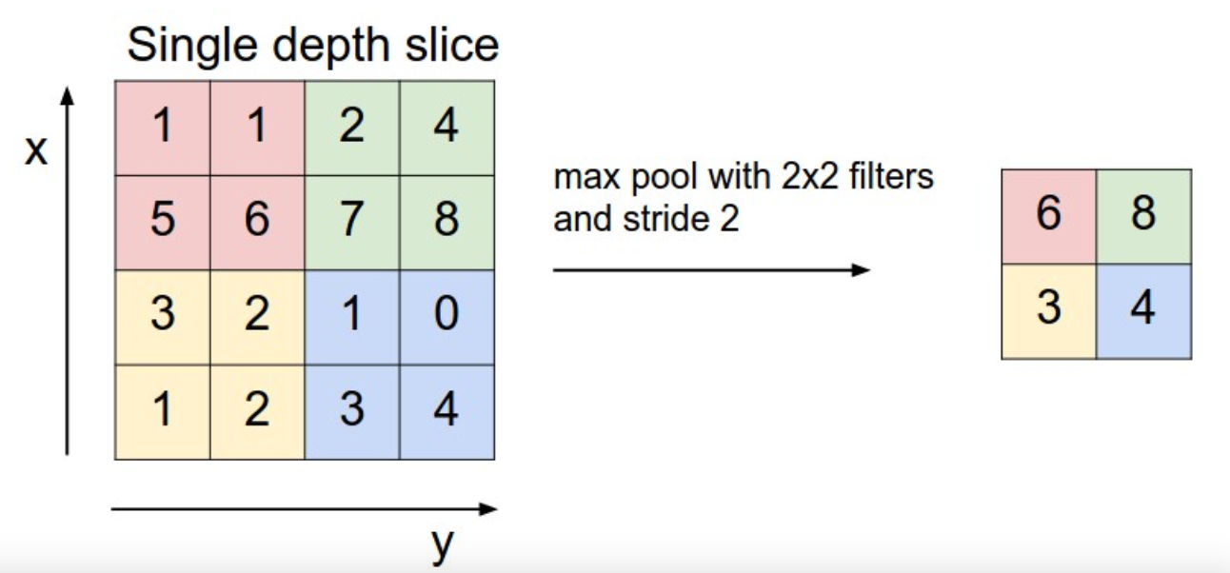
CNN – POOL
reduce the spatial dimension of an image

Slide 59
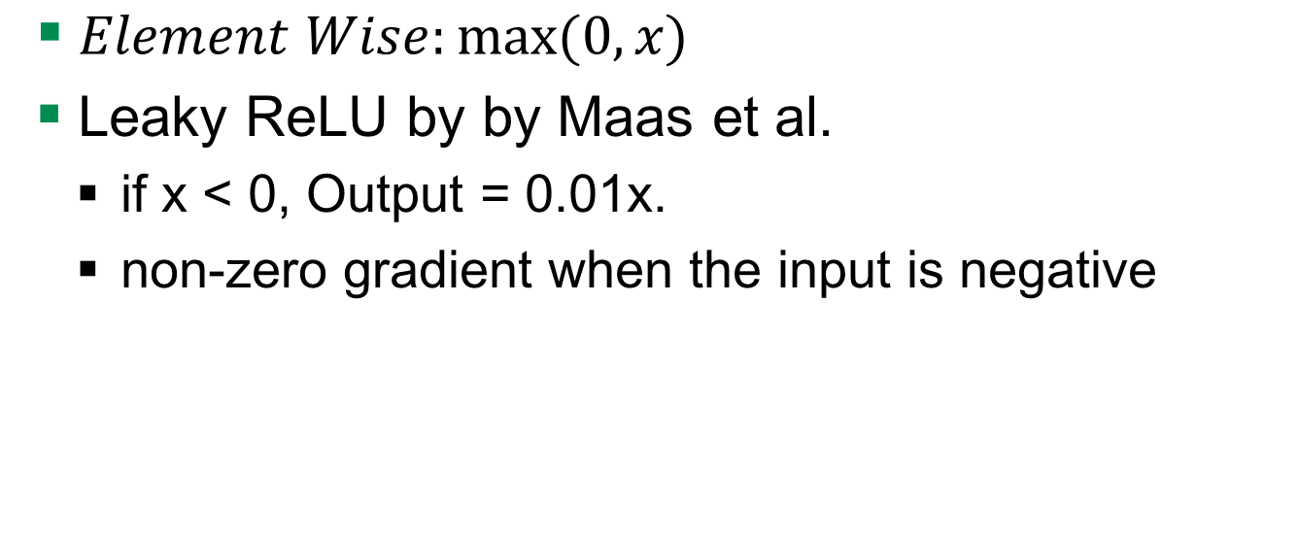
CNN – RELU
$Element Wise:max⁡(0, x)$
Leaky ReLU by by Maas et al.
if x < 0, Output = 0.01x.
non-zero gradient when the input is negative

Slide 60
CNN Parameters
Can be trained on an endless amount of parameters:
learning rate, learning rate decay
momentum
filter size, number of convolutional layers
activation functions (relu, leakyrelu)
Regularisation weight decay and dropouts

Slide 61
Momentum
Rolling ball gains speed downwards the hill
So, velocity to the learning rate in a given direction
With consistent gradient
Convolutional neural networks commonly use a momentum value of 0.9

Slide 62
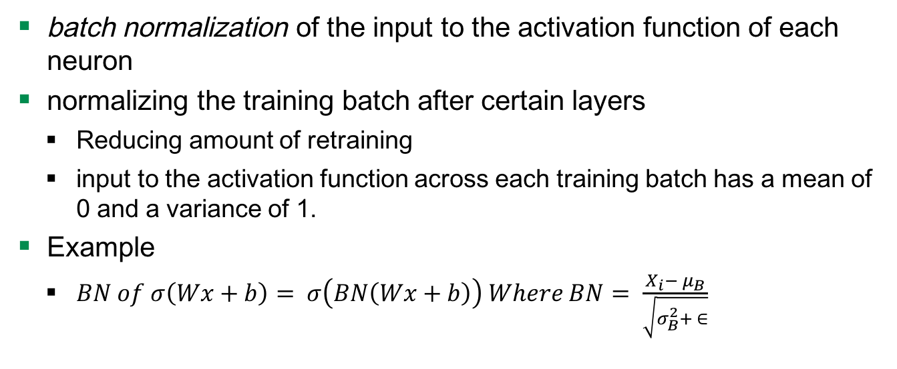
Batch Normalization (BN)
batch normalization of the input to the activation function of each neuron
normalizing the training batch after certain layers
Reducing amount of retraining
input to the activation function across each training batch has a mean of 0 and a variance of 1.
Example
$BN of σ\left(Wx+b\right)= σ\left(BN\left(Wx+b\right)\right) Where BN= \frac{X_{i}− μ_{B}}{\sqrt{σ_{B}^{2}+ ∈}}$
Notes:
The amount of re-training weights within deeper layers of a network have to do as a result of earlier layers changing their weights and thus their output values.
Changes in model parameters during learning change the distributions of the outputs of each hidden layer. This means that later layers need to adapt to these (often noisy) changes during training.

Slide 63
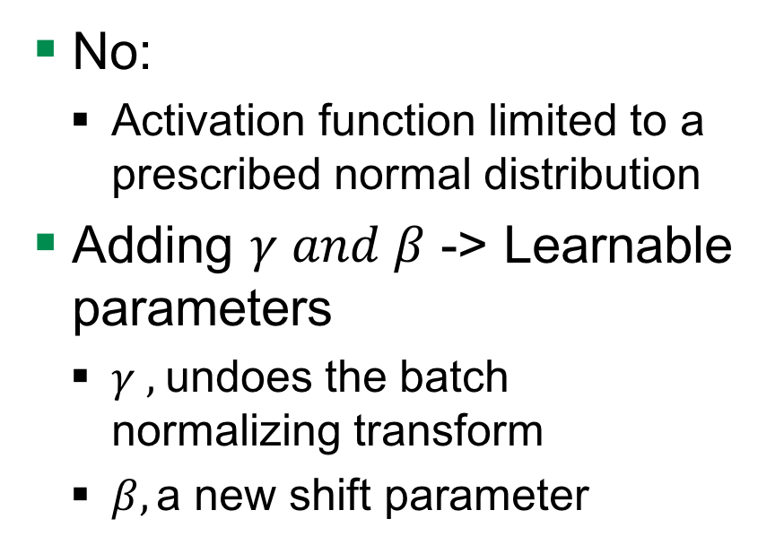
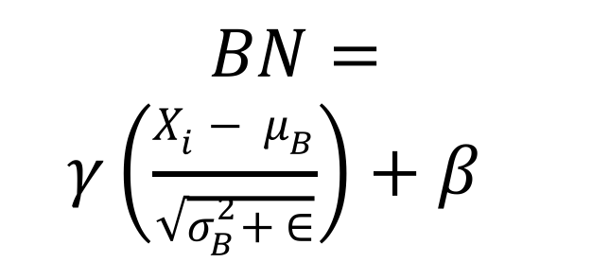
Is BN enough ?
No:
Activation function limited to a prescribed normal distribution
Adding $γ and β$ -> Learnable parameters
$γ ,$undoes the batch normalizing transform
$β,\text{a} \text{new} \text{shift} \text{parameter}$
$$BN=$$
$$γ\left(\frac{X_{i}− μ_{B}}{\sqrt{σ_{B}^{2}+ ∈}}\right)+β$$
Notes:
Because the batch normalizing transform given above restricts the inputs to the activation function to a prescribed normal distribution, this can limit the representational power of the layer. Therefore, we allow the network to undo the batch normalizing transform by multiplying by a new scale parameter γγ and adding a new shift parameter ββ. γγ and ββ are learnable parameters.

Slide 64
Cifar10 Weight Decay
weight_decay = tf.mul(tf.nn.l2_loss(var), wd, name='weight_loss')
tf.add_to_collection('losses', weight_decay)

Slide 65
Weight Penal

Slide 66
TensorFlow
Developed by Google Brain Team
Use cases
Handwritten patterns, image recognition, Word2Vec
Input data
Audio, image, text
Used techniques
Linear classifiers, NN
Notes:
Google Brain Team is a deep learning research project at Google

Slide 67
Limitations
150 images viewed
1 duplicate
1 wrong content
Training lasts long
Reduced image size

Slide 68
TF Implementation: Prediction
Cifar10.Inference()
Conv1: convolution and rectified linear activation.
Pool1: max pooling.
Norm1: local response normalization.
Local3: fully connected layer with rectified linear activation.
Local4: fully connected layer with rectified linear activation.
Softmax_linear: Linear transformation to produce logits.

Slide 69
Hyperparameters
Learning Rate

Slide 70
Results
Precision 0.83
Notes:
Graphics have to be added

Slide 72


CNN – Conv Layer
1
.11
-1 | 1 | -1
1 | 1 | 1
-1 | 1 | -1
1 | 1 | 1
1 | 1 | 1
1 | 1 | 1
$$1/9$$
Feature 1

Slide 73
Problem Statement
I am DOG
...No No...
I am CAT

Slide 74
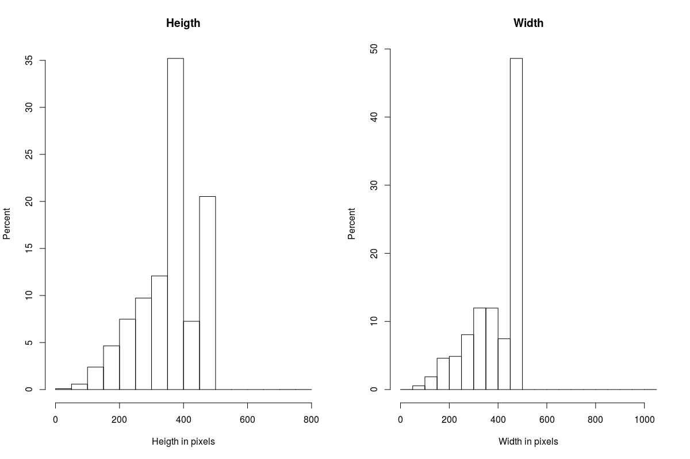
Ratio

Slide 75
input
conv
pool
norm
conv
norm
pool
local
local
Softmax linear

